Slide 1
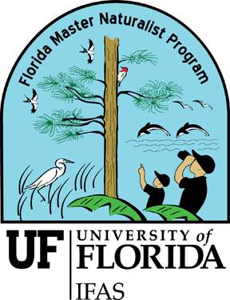
Florida Master Naturalist Program A Statewide Conservation Education Effort
Dr. Martin Main UF/IFAS Professor and
Wildlife Ecologist
FMNP Program Leader
Sandy K. Mickey UF/IFAS Biological Scientist
and Naturalist
FMNP Program Coordinator

Slide 2
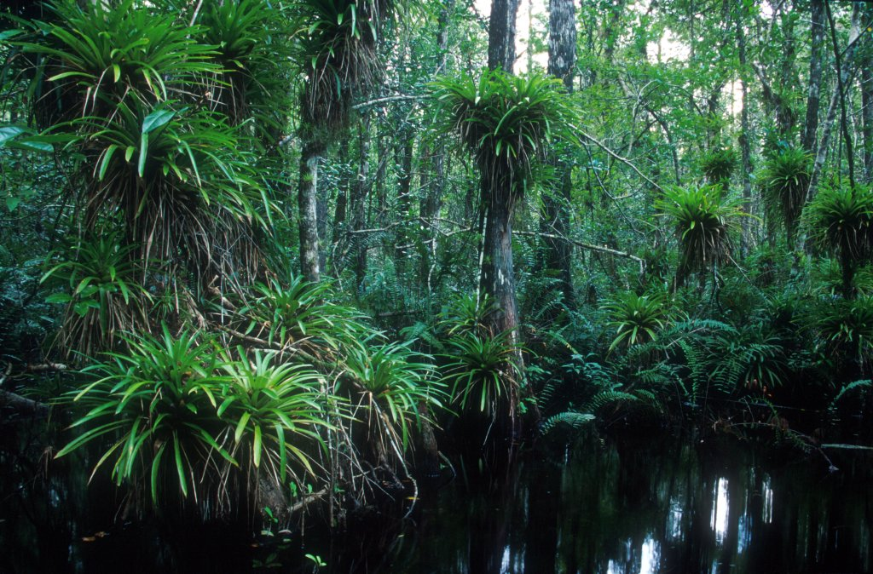
Florida Master Naturalist Program Mission...
...to increase awareness, understanding, and respect of Florida's natural world
among Florida's citizens and visitors.
Teach those who teach others

Slide 3
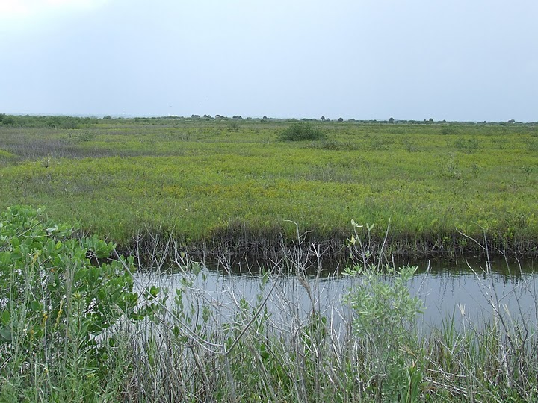
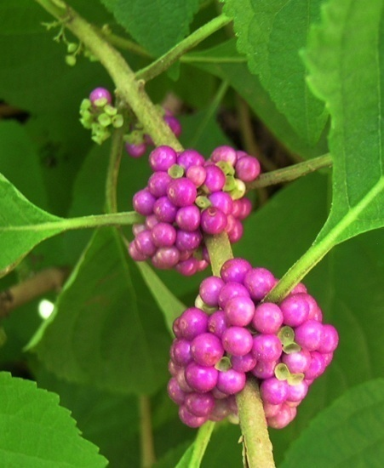
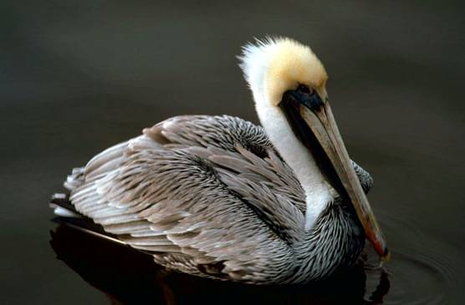
What is the FMNP?
- an ecological and conservation focus -
3 Ecosystem Modules Taught Separately
- Freshwater Wetlands
- Coastal Systems
- Upland Habitats
For the novice or expert
Notes:
You can take one, two or all three modules. There is no requirement to complete all three, but those that do earn Honor Roll status. There is also no volunteer commitment.

Slide 4
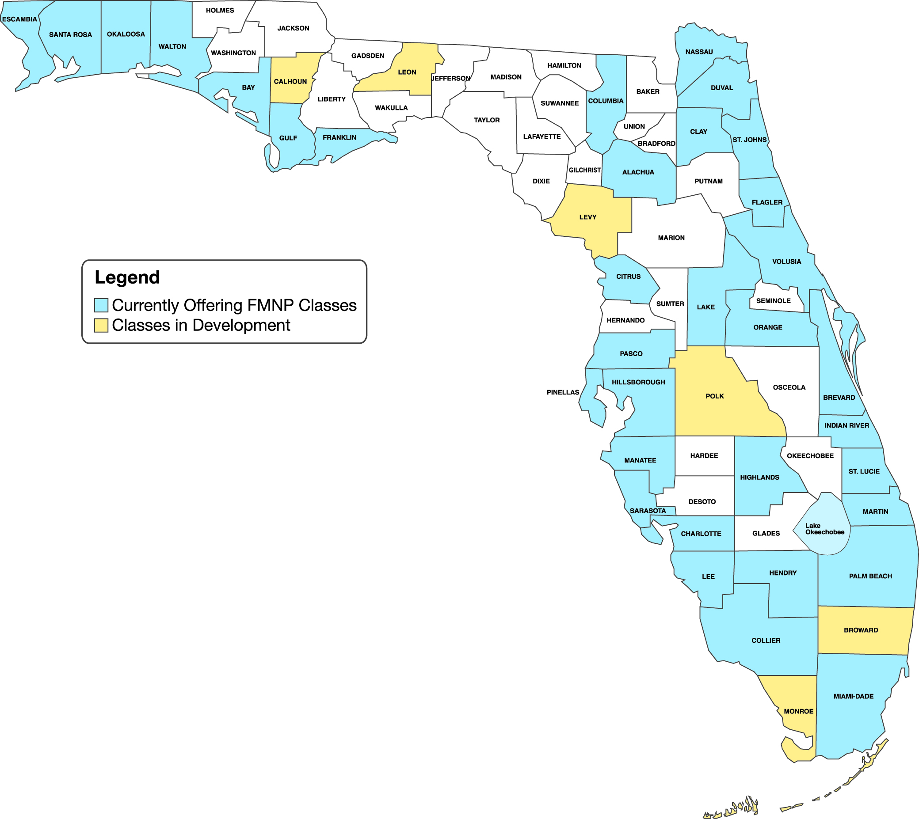
Statewide Environmental Education

Slide 5
And We’re Growing

Slide 6
Who are the FMNP Instructors?
~140 environmental educators from ~75 organizations
UF Extension & Sea Grant
Non-profit Organizations
Natural Resource Agencies
Parks, Zoos, Museums
Nature Centers
Academic Institutions
-- diversity is a strength --

Slide 7
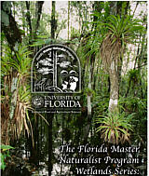
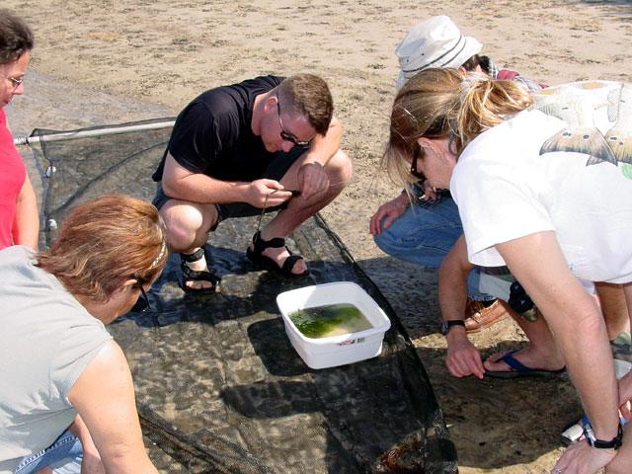
Statewide Program Offers Consistency…
Student workbooks
Classroom presentations (12)
Videos (4)
Field trips (3)
Final student projects
…While Providing Local Information
Notes:
--- 4 videos - 3 ecology - 1 issues/module
provide STATEWIDE overviews of ecosystem processes, habitats, and conservation issues designed to set the stage for more detailed presentations issues designed to promote discussion - NOT present “right” and “wrong”
--- 12 slide presentations to provide detail on concepts and principles, species identification among major taxonomic groups, environmental ethics, and interpretation skills used by Instructors as both instructional tools and templates from which to share personal knowledge of local flora and fauna
---Student and instructor workbooks
Student Workbooks provide presentations, reference information, learning exercises, etc. Instructor workbooks provide presentation notes, administrative details, suggested classroom and field trip components, etc.

Slide 8
What are the Major Components?
Classroom
Notebooks and resources
PowerPoint presentations
Videos & worksheets
Discussion
Field Trips
Local topics & exploration
Practice Interpretation Skills
Synthesis of information and practical experience (final projects)

Slide 9
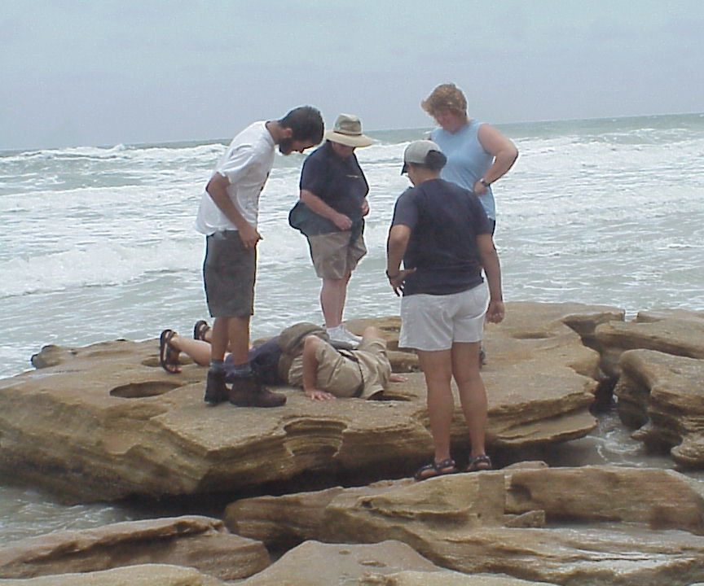
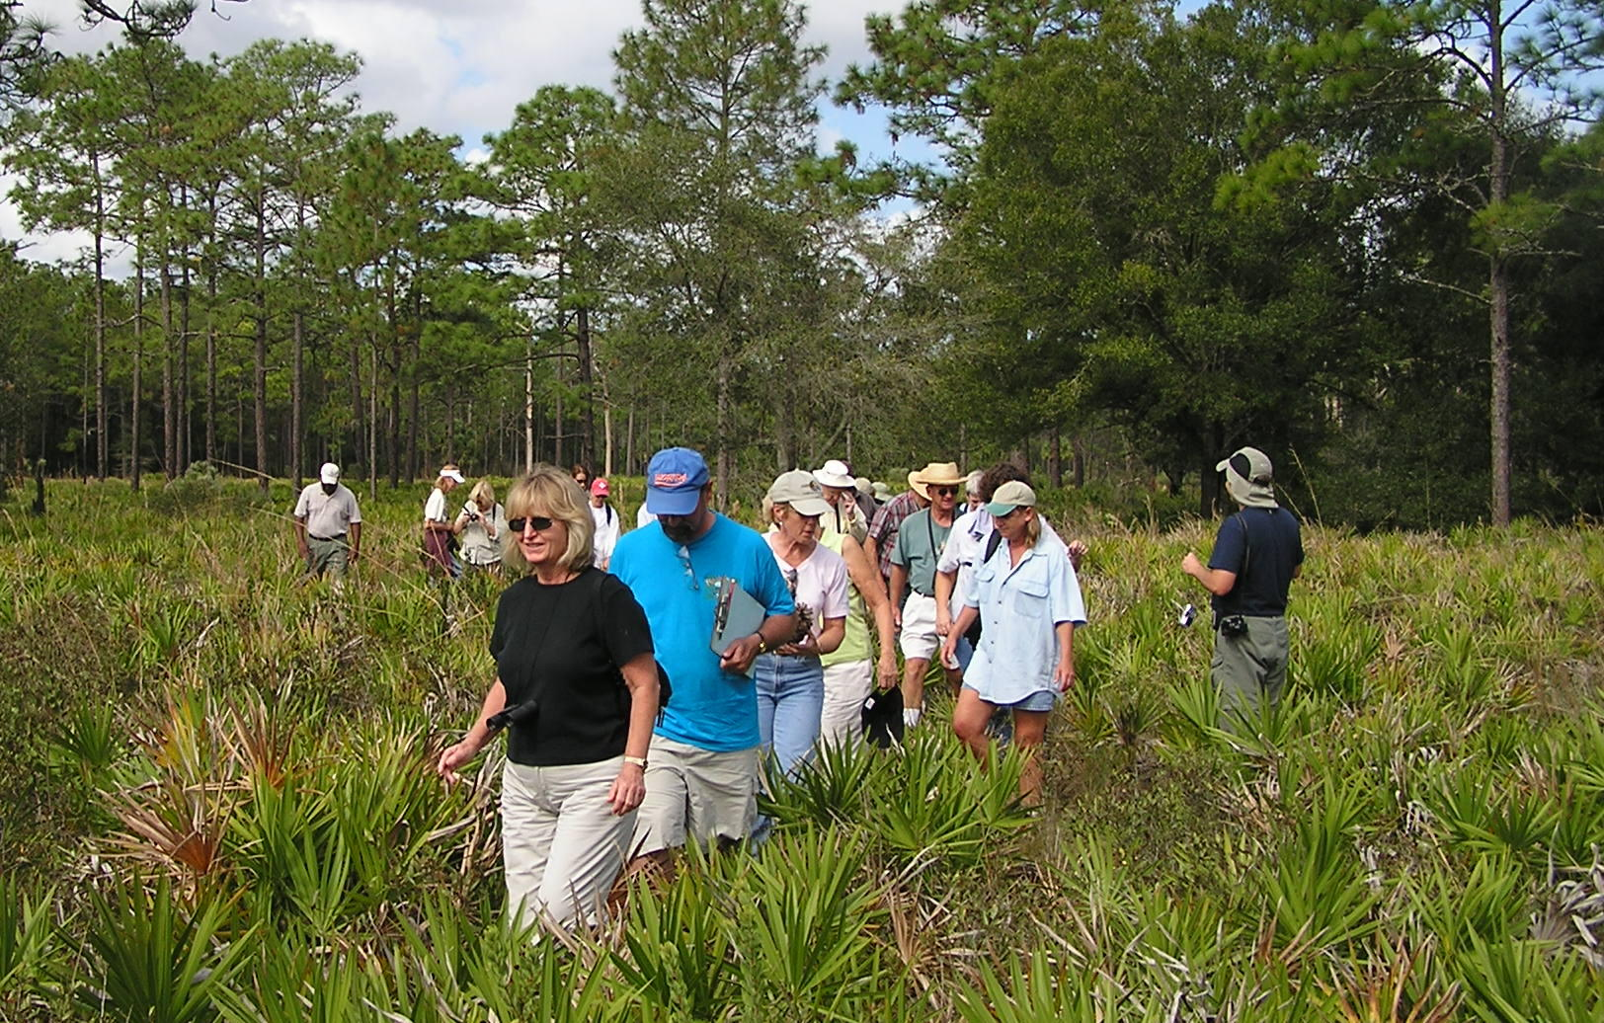
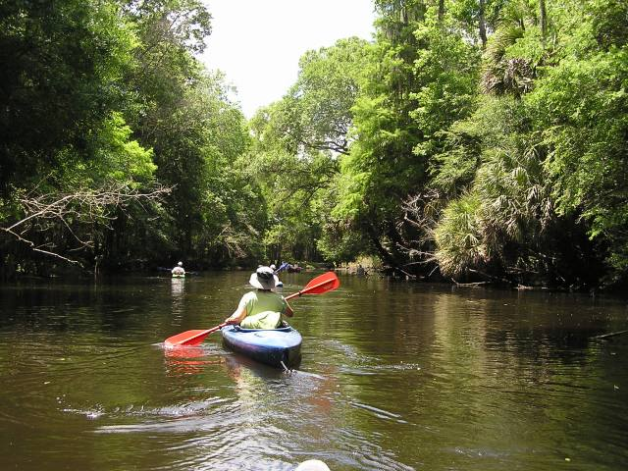
Module Components
Uplands Module
Pinelands
Hardwoods
Scrub, Prairie & Range
Coastal Module
Estuaries
Nearshore Habitats
Coastal Uplands
3 field trips reflect the three habitats of each module
Freshwater Module
Marshes
Swamps
Lakes, Rivers & Springs

Slide 10
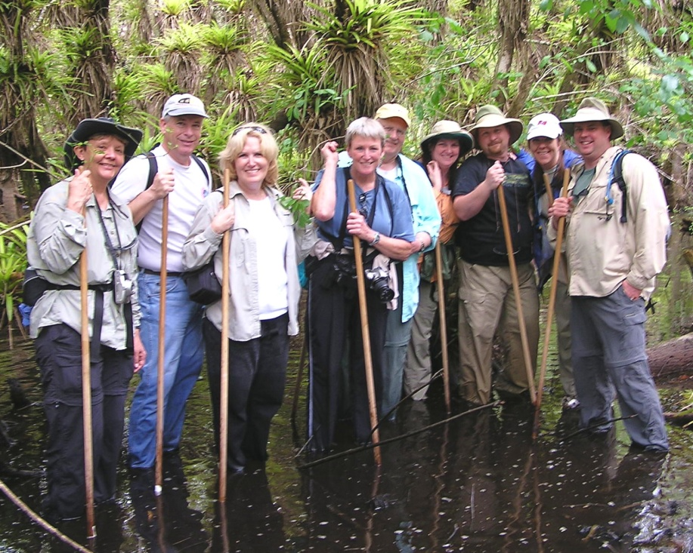
Who should take FMNP?
Natural Resource
Professionals
Ecotourism Guides
Teachers
Volunteers & Employees of
Parks
Nature centers
Museums and historical sites
Environmental education organizations
Anyone interested in the natural world!
Notes:
Our audience is inclusive, not exclusive. Our program requires attendance and participation in class, and completion of final projects. And, although the FMNP encourages volunteer service, volunteer service is not a requirement. To require volunteer service would alienate many potential participants, such as ecotour guides, teachers, and natural resource professionals – persons that benefit from FMNP training, and extend those benefits to others through educational programs. A volunteer requirement also competes with volunteers from other organizations, such as state parks and nature centers – the very organizations we are trying to assist.
Interested persons can take the program - whether novice or expert. This mix is actually beneficial. Experts can bring much to the class, and elevate the quality of the experience for others. Persons with knowledge are encouraged to contribute to the class.
The FMNP is not a typical class, with the “sage on the stage,” but a group of adults getting together to learn, share experiences, knowledge, and perspectives. Graduates are encouraged to use this information to inform and educate others and - hopefully - help make a difference in Florida’s future.

Slide 11
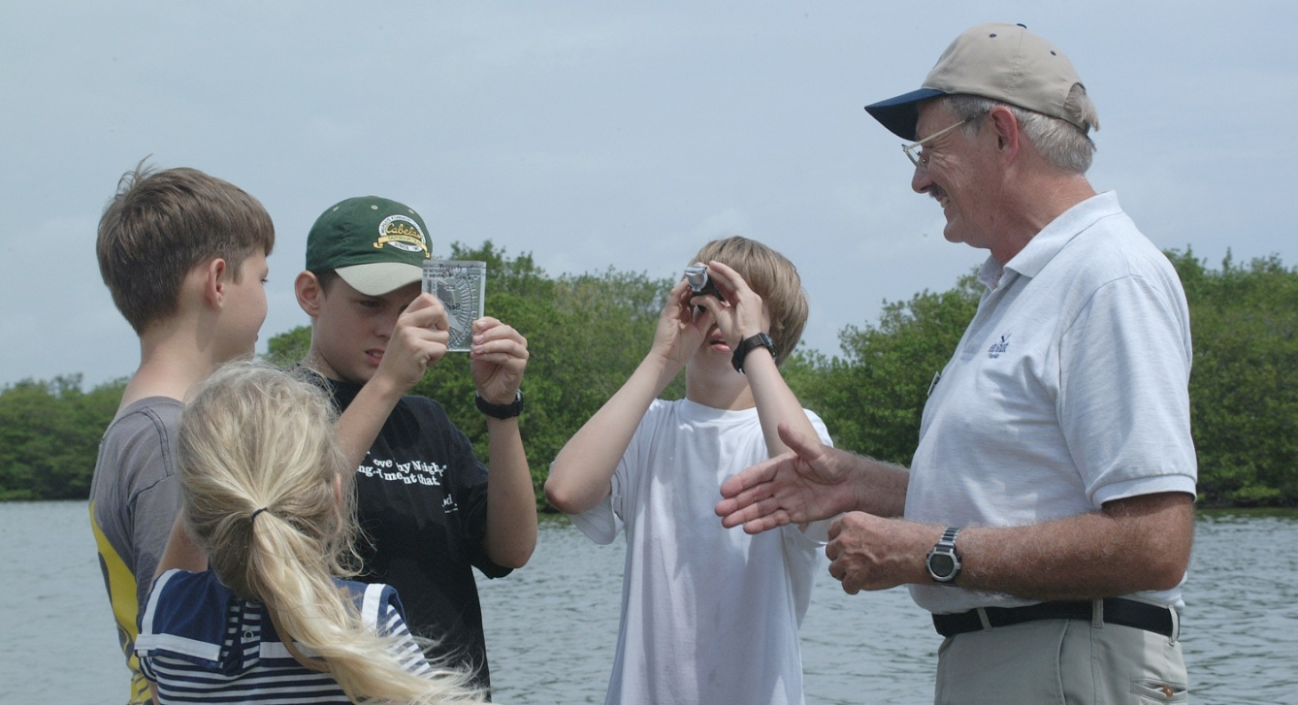
Teachers!
Can earn 40 hours of in-service for each module
Obtain resources for your lessons
Gain interpretive skills for teaching conservation
Private classes can be arranged for teachers
Final project can be used for your classroom

Slide 12
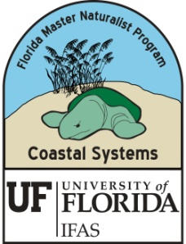
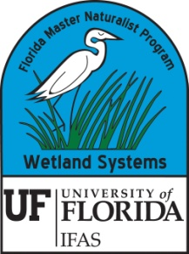
What’s Included
Each module is $225
Student workbooks and resources
3 Field trips
Classroom instruction
Practical experience
Graduation certificate
Honor Roll plaque and pin if completing 3rd module
FMNP patch
FMNP pin
Listing in on-line student database
Networking, chapter membership, listserv

Slide 13
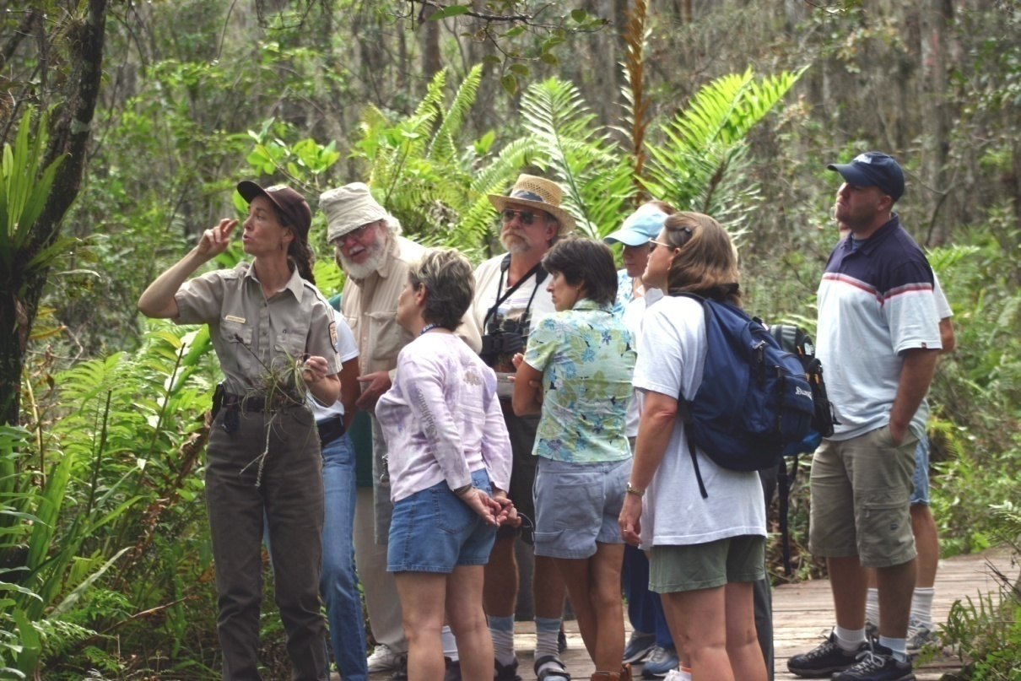
What are the benefits?
State-wide recognition and respect
Volunteer opportunities
Job opportunities
Community involvement
Networking
Personal fulfillment
Accreditation
Marketing

Slide 14
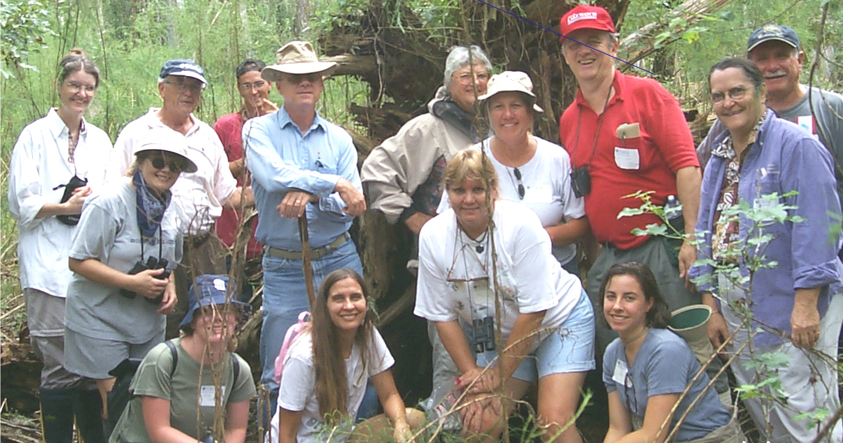
Highlights - FMNP Graduate Surveys
New jobs (7%)
New volunteer position (13%)
Pay raises/promotions (3%)
Increased responsibility (30%)
In-service credit (43%)
Share info with others (97%)

Slide 15
Testimonials
I got the job of assistant park ranger…FMNP helped me get that foot in the door.
I have become President of my local Native Plant Society
I was accepted as an “expert witness” by a judge for my FMNP certification
We have developed a nature program for youth at Ritz-Carlton Naples that has received high acclaim
Part of my final project was used at the Florida Native Plant Conference in 2006
I got a volunteer position in England due to my FMNP certification
I expanded my job responsibilities that helped secure full-time University employment
I recently received a Senate appointment because of the FMNP
The class opened my eyes to how much I love and enjoy nature. It was the best class I ever took!

Slide 16
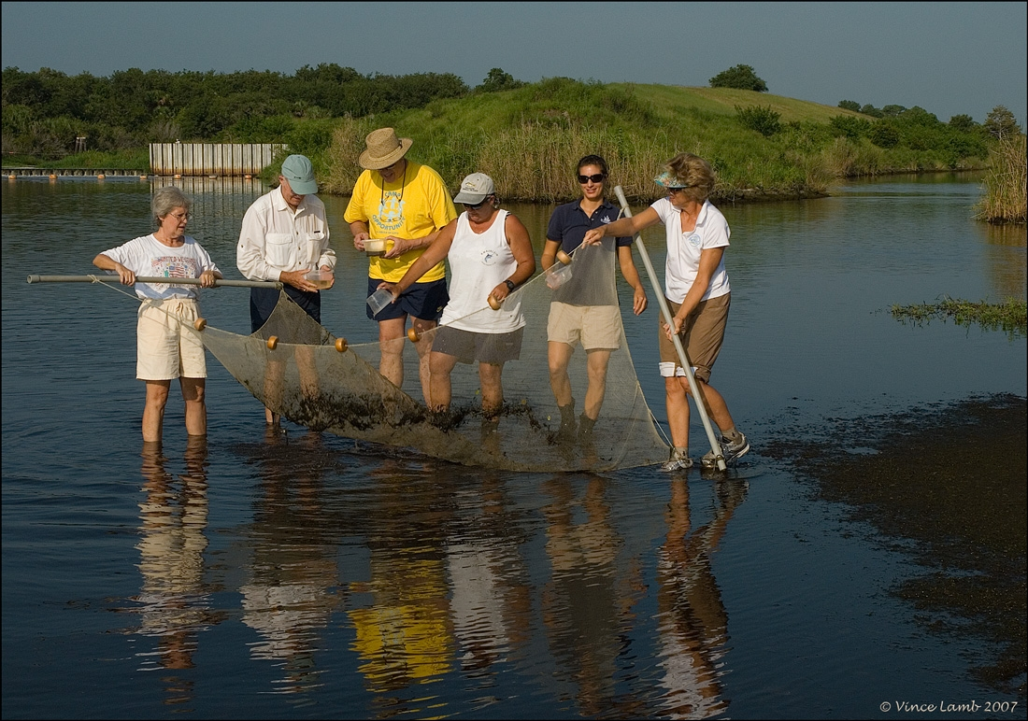
Special Topics Courses
24 hours of practical experience
Modules not required
Detail and field oriented
Conservation Science
Environmental Interpretation
Wildlife Monitoring (available soon)
Habitat Evaluation (available soon)

Slide 17
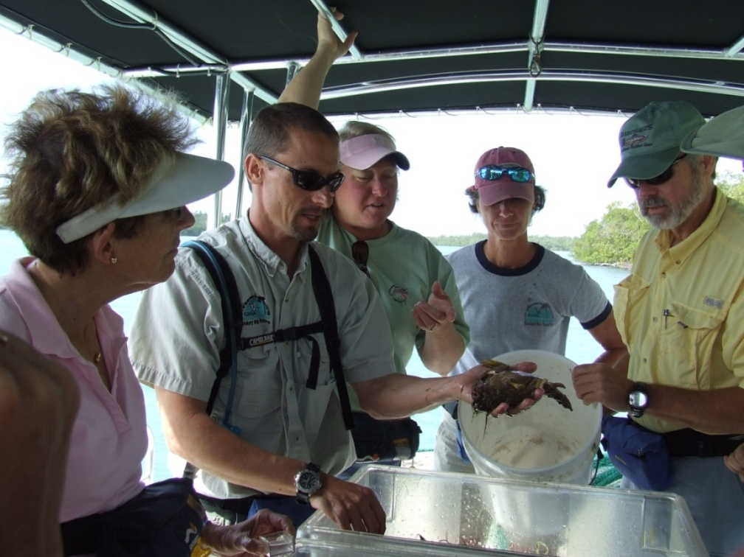
Want to become an Instructor?
Bachelor’s degree or comparable experience
Affiliation with organization that supports EE and FMNP
Classroom space
Application process and peer review
Geographical need
Free training and materials

Slide 18
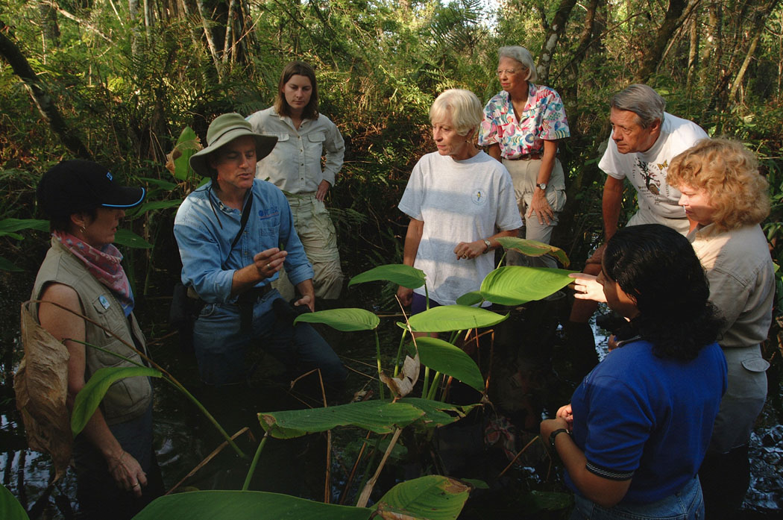
www.MasterNaturalist.org

